Slide 1
An introduction to some digital tools for Bayesian Data Analysis (BDA)
Alan Pickering
Dept. of Psychology
Goldsmiths, University of London
a.pickering@gold.ac.uk

Slide 2
Part A: Historical and Conceptual Background

Slide 3
Preliminaries
All the materials for this set of workshops/tutorials are in an open access repository
https://github.com/Alan-Pickering/Bayesian-data-analysis-teaching
These slides are there
Bayesian Data Analysis Part A.pptx
as are later powerpoint tutorials, explainer documents and my code in Matlab

Slide 4
Overview
What is Bayes Theorem?
Key terms and concepts

Slide 5
What is Bayes Theorem?
Excellent paper on its foundations and basic concepts
Etz, A., & Vandekerckhove, J. (2018). Introduction to Bayesian Inference for Psychology. Psychonomic Bulletin & Review, 25(1), 5–34.

Slide 6
What is Bayes Theorem?
An Essay towards solving a Problem in the Doctrine of Chances.
Published in the Phil. Transactions of the Royal Society of London in 1763, after Bayes’ death, by his friend Richard Price, a Unitarian minister who was literary executor of his estate. Price wrote many comments and additions to the text.

Slide 7
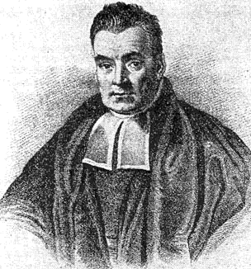
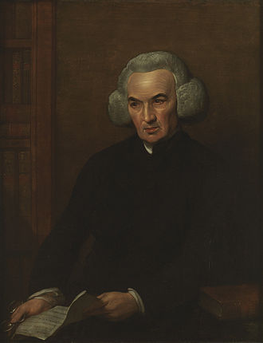
Bayes and Price

Slide 8
What is Bayes Theorem?
Main statement of the theory was a minor component of the essay, which addressed a broader problem
"If there be two subsequent events, the probability of the second b/N and the probability of both together P/N, and it being first discovered that the second event has also happened, from hence I guess that the first event has also happened, the probability I am right is P/b.“

Slide 9
In modern notation
Which implies :-

Slide 10
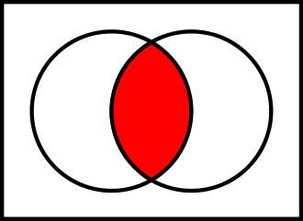

Slide 11
Key Bayesian terms
y is the data; θ are the model parameters

Slide 12
Bayes Theorem
It is often described as a theorem about inverse probability
We know about forward probabilities: if it is a fair deck of cards (FD) what is the probability that a card, drawn at random, will be a spade (S)?
Answer= 1/4
P(S|FD)=1/4

Slide 13
Inverse probability
If we draw a spade at random (S) what is the probability that it is a fair deck (FD)?
What is p(FD|S)?
We can use Bayesian inference, based on Bayes’ theorem, to work it out

Slide 14
Uses of Bayes’ Theorem: Future topics
1. Carrying out Bayesian statistical analyses
2. Using Bayesian methods to compare the fit of models to data (Bayesian Model Comparison)

Slide 15
Thanks for listening Please like the video (if you do) and subscribe to my channel. Hit the “bell” icon to get notifications of future screencasts

